Slide 1
Git
This week Study Overview

Slide 2
1. What is ______?
Git
Git is a version control system that intelligently tracks changes in files.
Git is particularly useful when you and a group of people are all making changes to the same files at the same time
https://docs.github.com/en/get-started/start-your-journey/about-github-and-git#about-git
GitHub
GitHub is a cloud-based platform where you can store, share, and work together with others to write code.
https://docs.github.com/en/get-started/start-your-journey/about-github-and-git#about-github
https://github.com/
Collaborative working, one of GitHub’s fundamental features, is made possible by the open-source software, Git, upon which GitHub is built.
https://marklodato.github.io/visual-git-guide/index-en.html
https://www.git-scm.com/

Slide 3
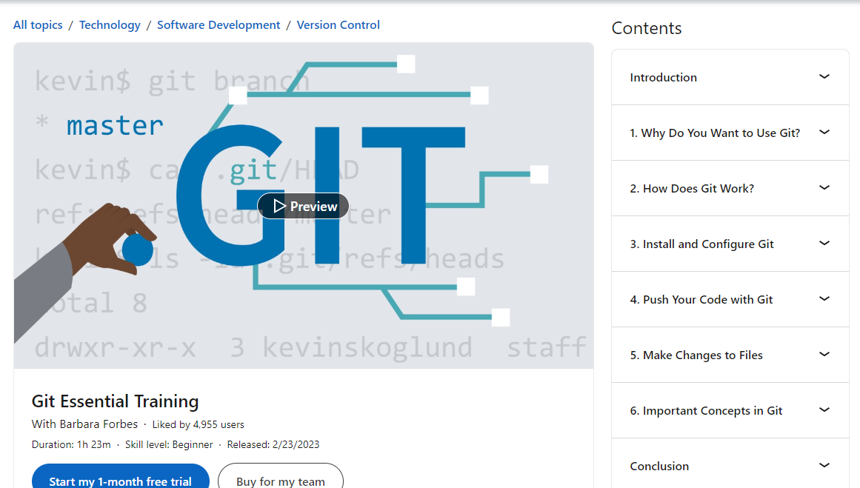
2. This week study overview
For all the coursework this week, use our Lab machine and/or your personal desktop.
Git Study
Study Git Essential Training by Barbara Forbes
https://www.linkedin.com/learning/git-essential-training-the-basics-2019
© 2024 Web Age Solutions All rights reserved

Slide 4
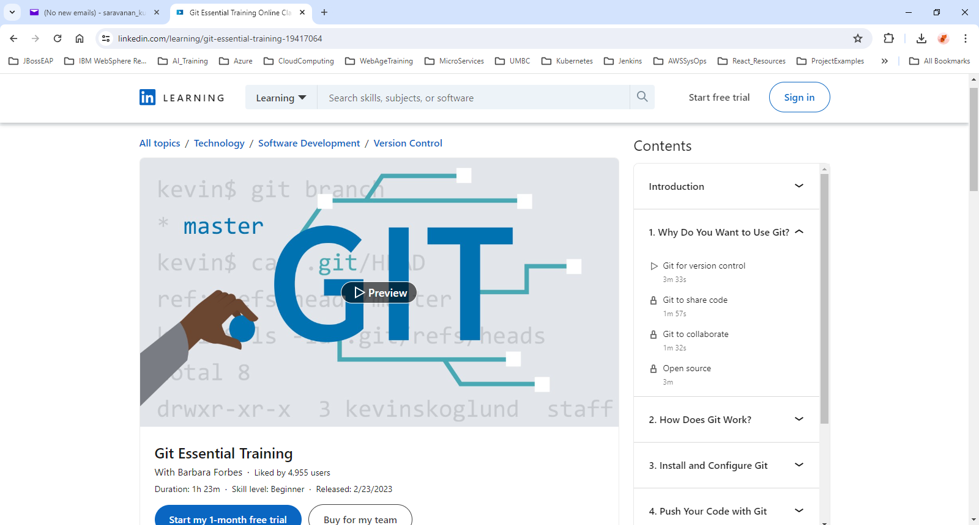
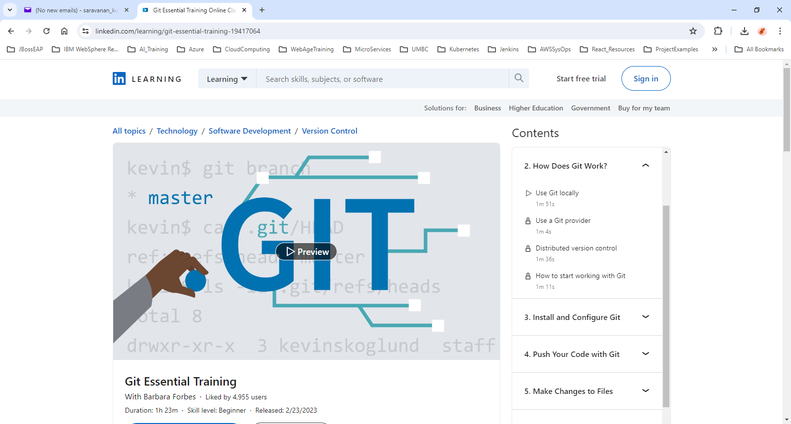
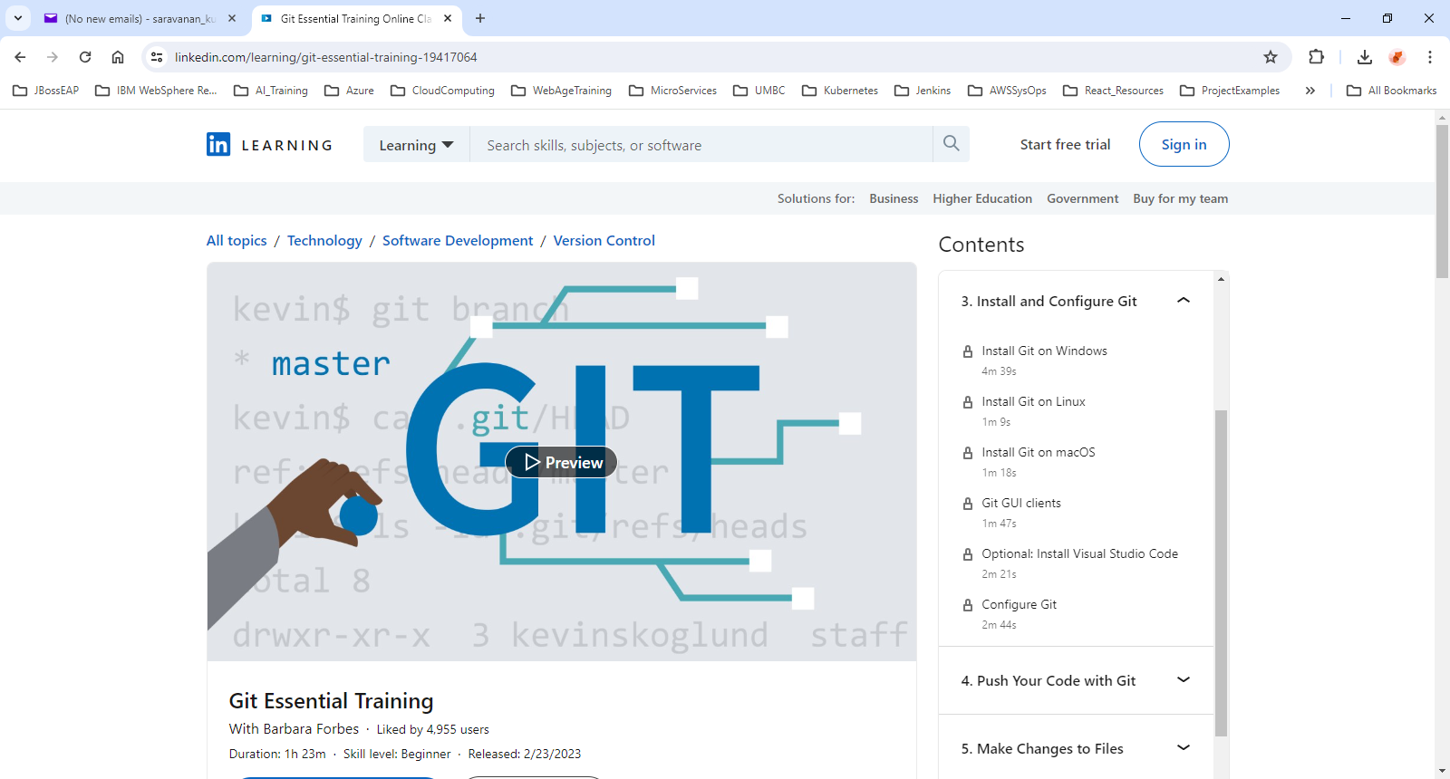
3. Git Essentials Training Overview
© 2024 Web Age Solutions All rights reserved

Slide 5
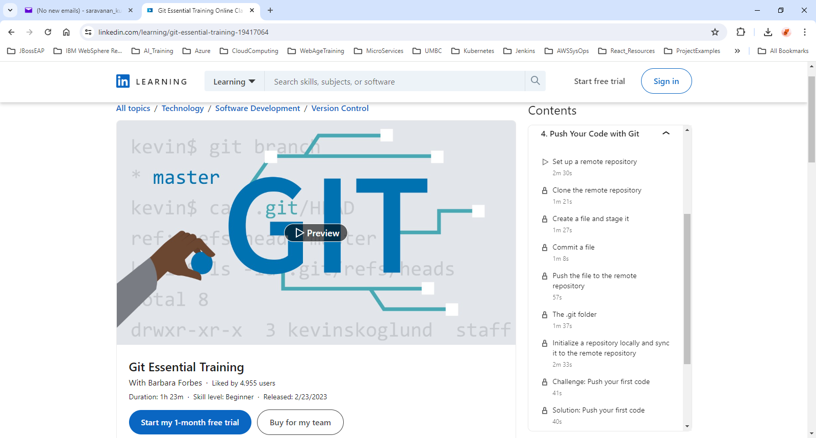
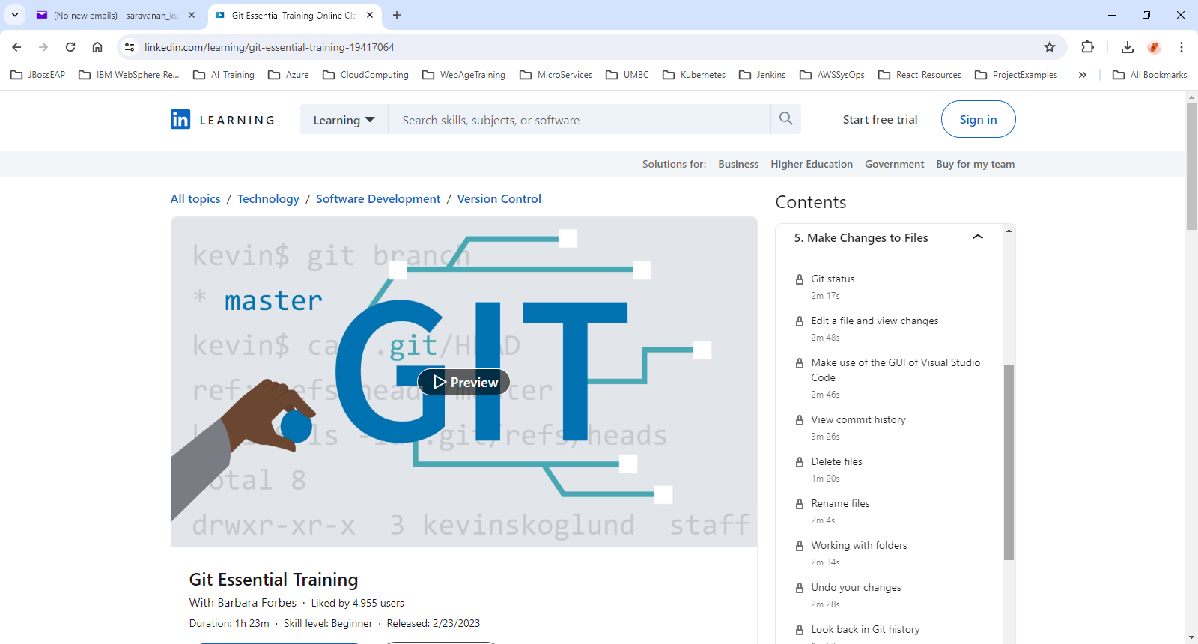
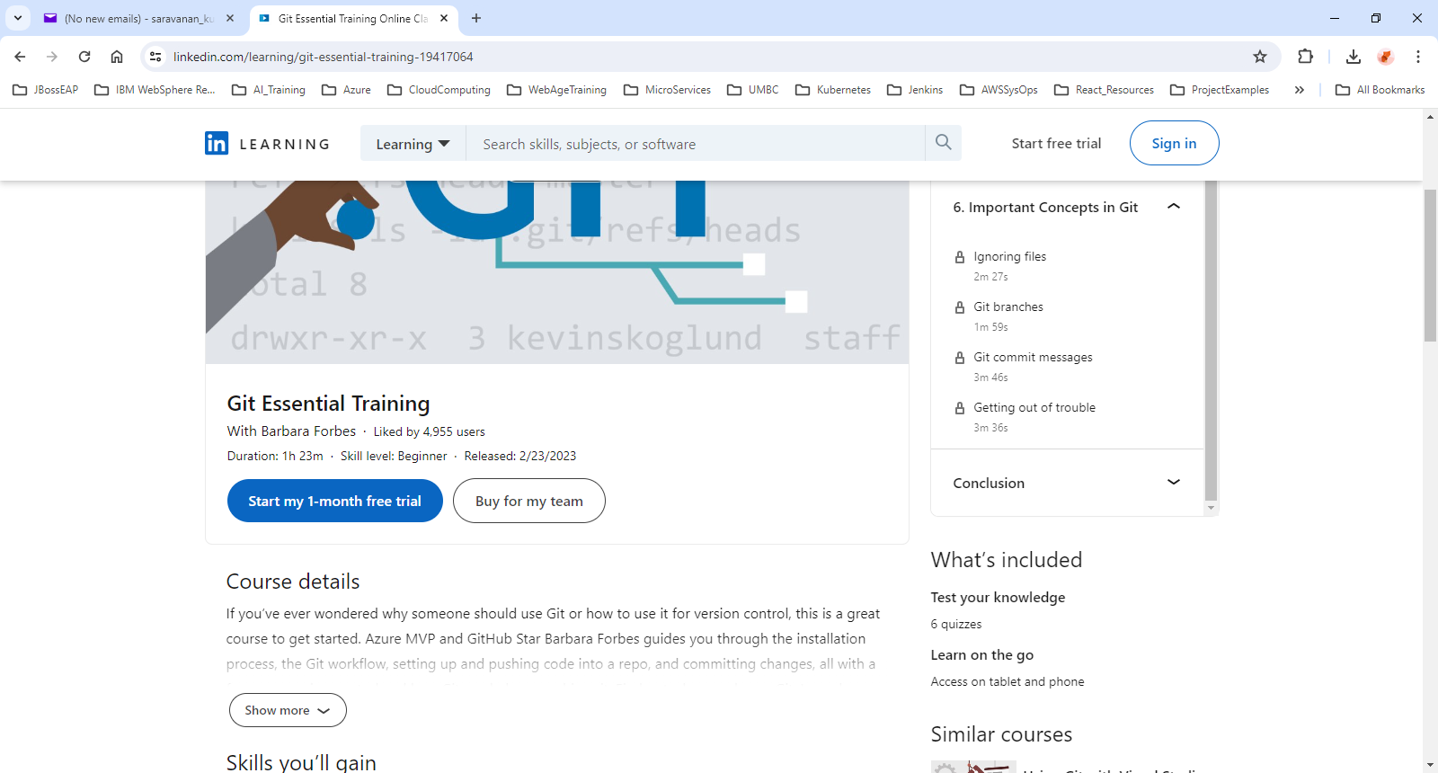
4. Git Essentials Training Overview
© 2024 Web Age Solutions All rights reserved

Slide 6
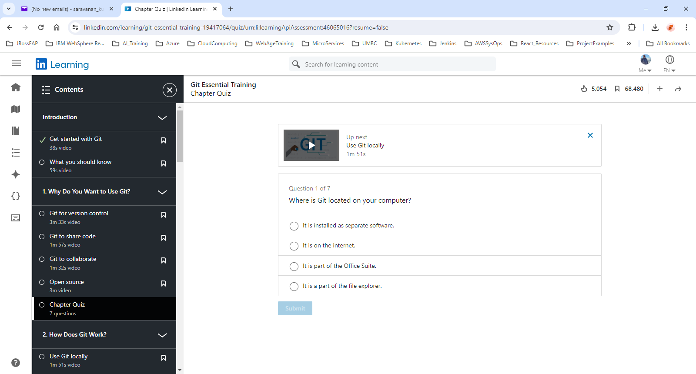
5. Git Essential Training Quizzes
Chapter 1- Why Do You Want to Use Git?
7 quiz questions
Chapter 2- How Does Git Work?
7 quiz questions
Chapter 3- Install and Configure Git
12 quiz questions
Chapter 4- Push Your Code with Git
13 quiz questions
Chapter 5- Make Changes to File
22 quiz questions
Chapter 6- Important Concepts in Git
7 quiz questions

Slide 7
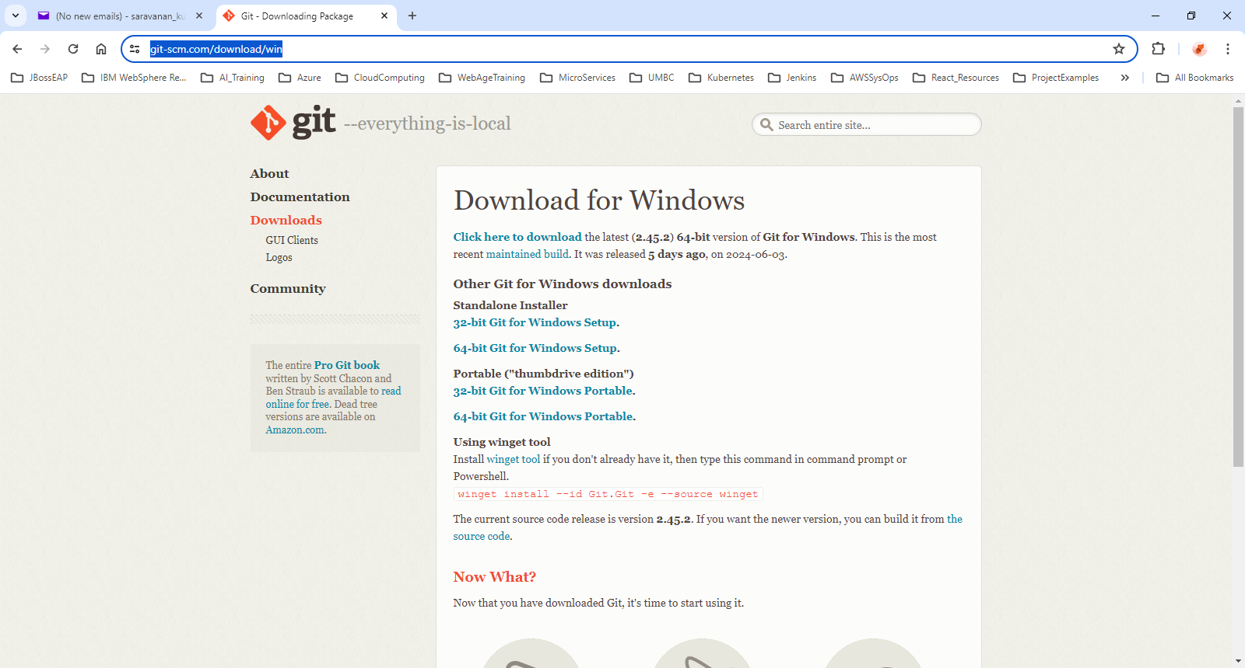
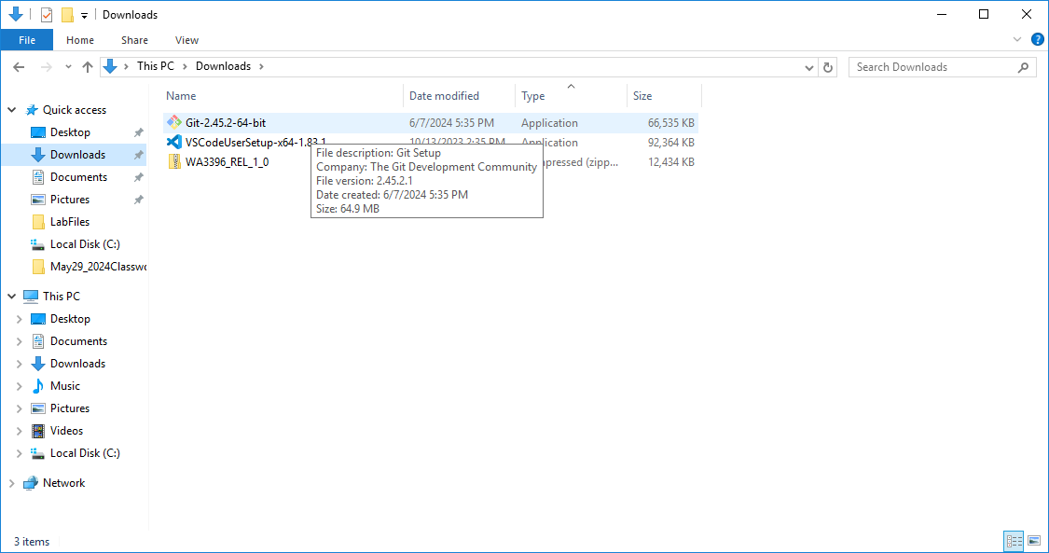
6. Download Git
https://www.git-scm.com/downloads
https://www.git-scm.com/download/mac
https://www.git-scm.com/download/win
https://www.git-scm.com/download/linux

Slide 8
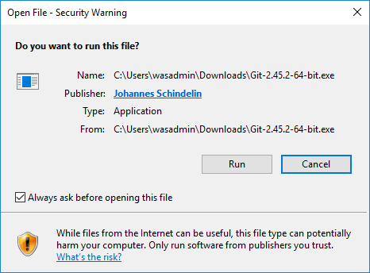
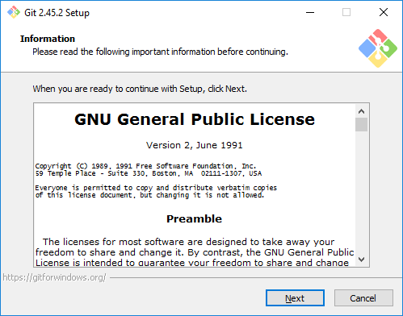
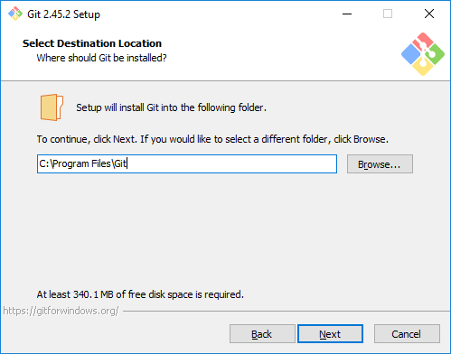
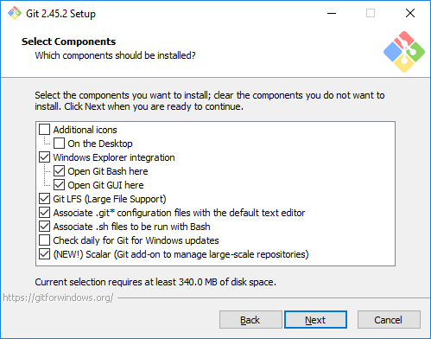
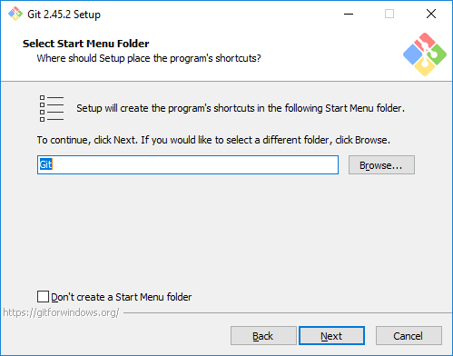
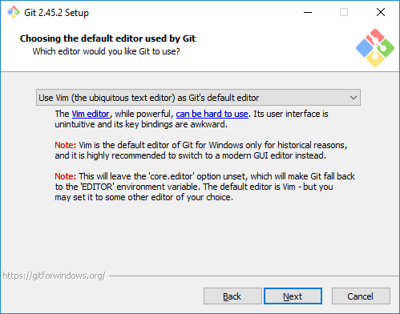
7. Install Git Steps 1 - 6
1
2
3
4
5
6

Slide 9
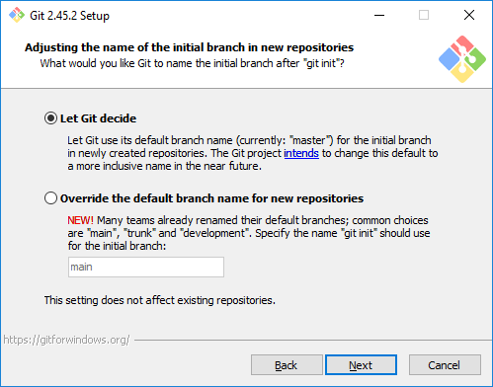
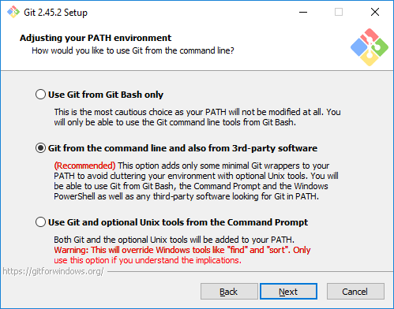
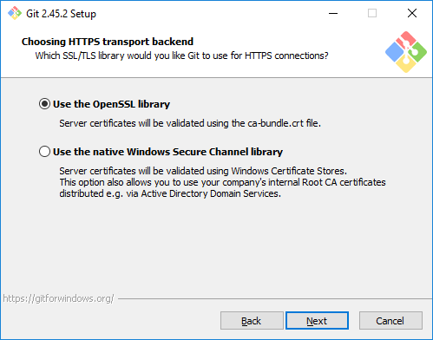
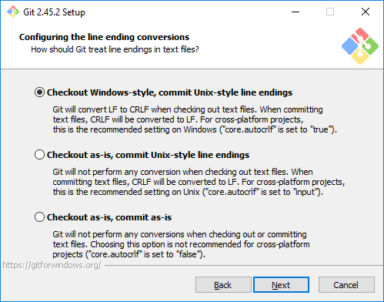
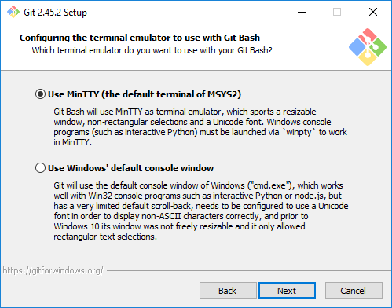
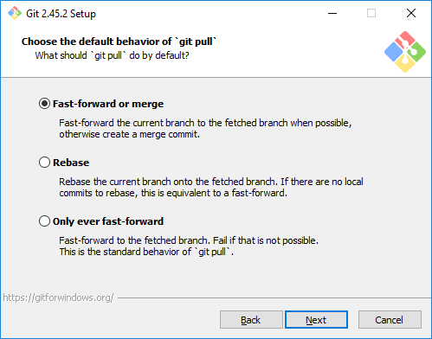
8. Install Git Steps 7 - 12
7
8
9
10
11
12

Slide 10
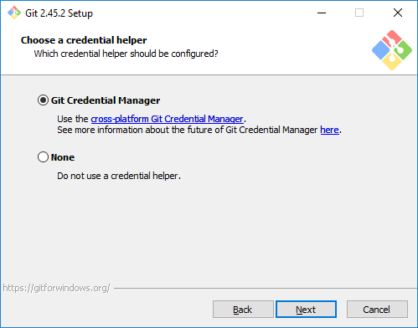
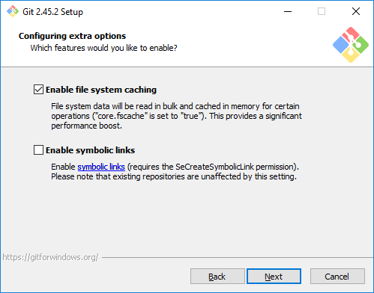
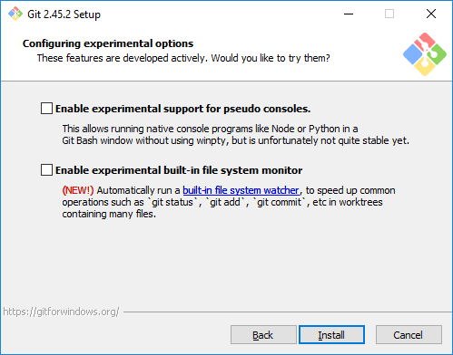
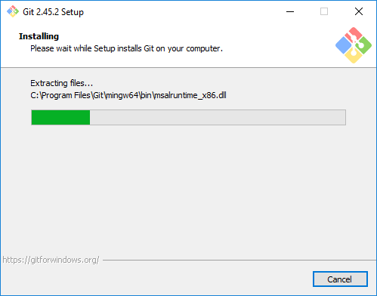
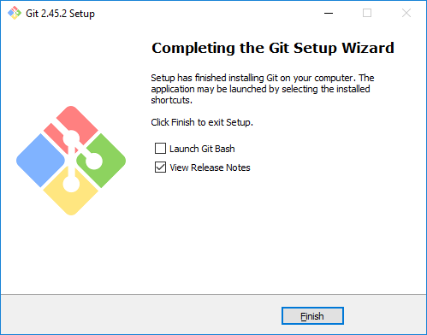
9. Install Git Steps 13 - 17
13
14
15
16
17

Slide 11
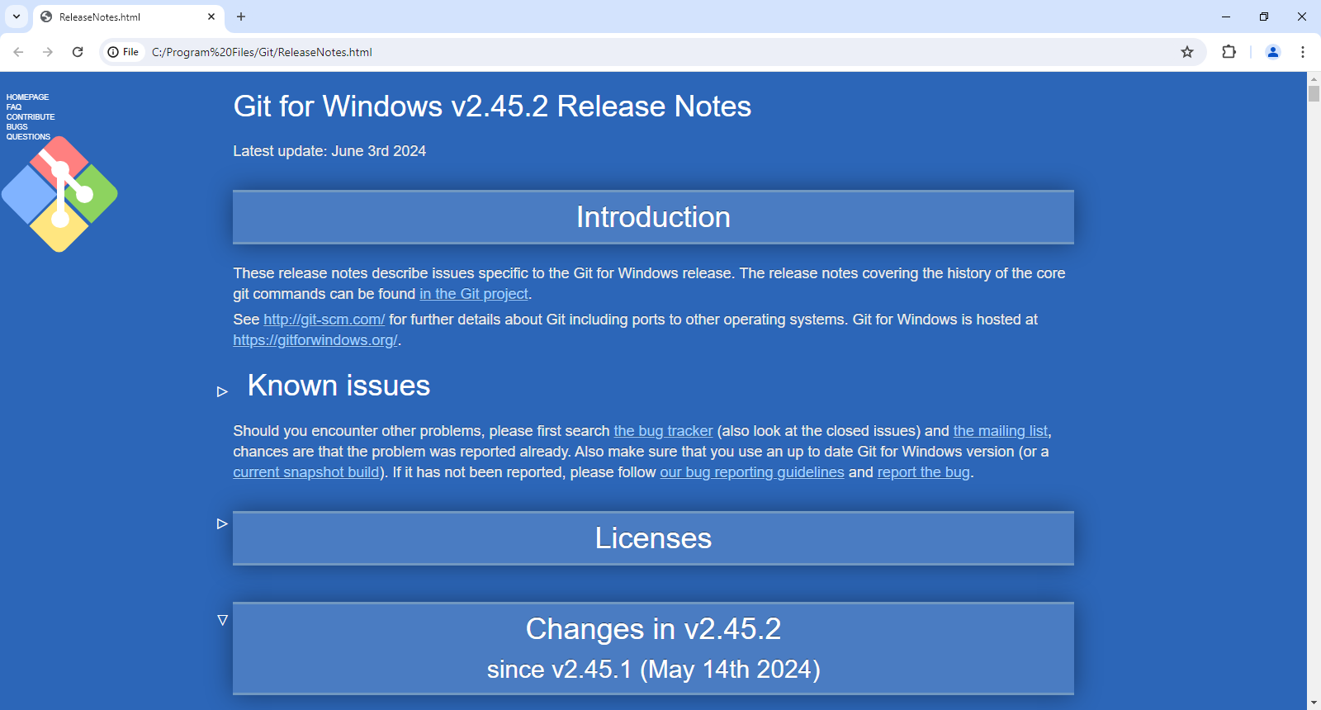
10. Git for Windows Release Notes

Slide 12
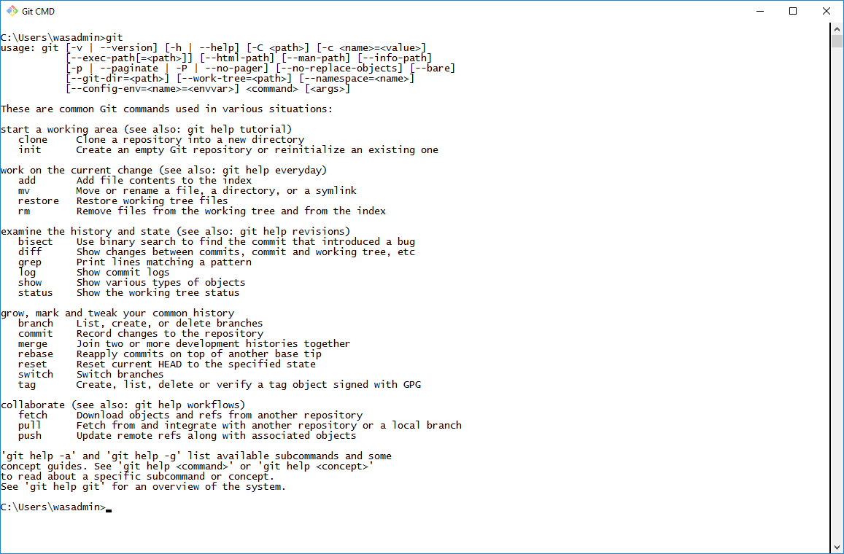
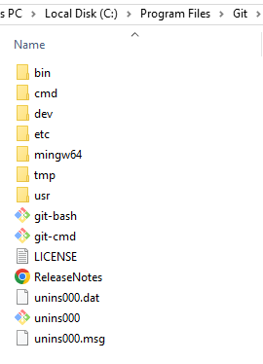
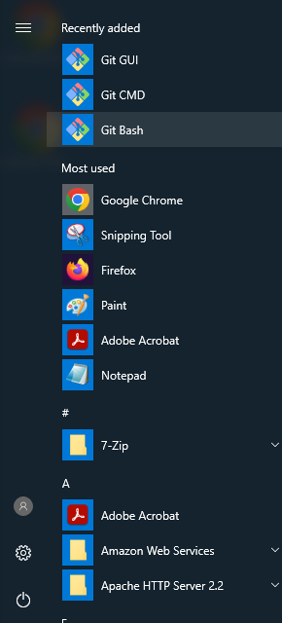
11. Git Installation Details

Slide 13
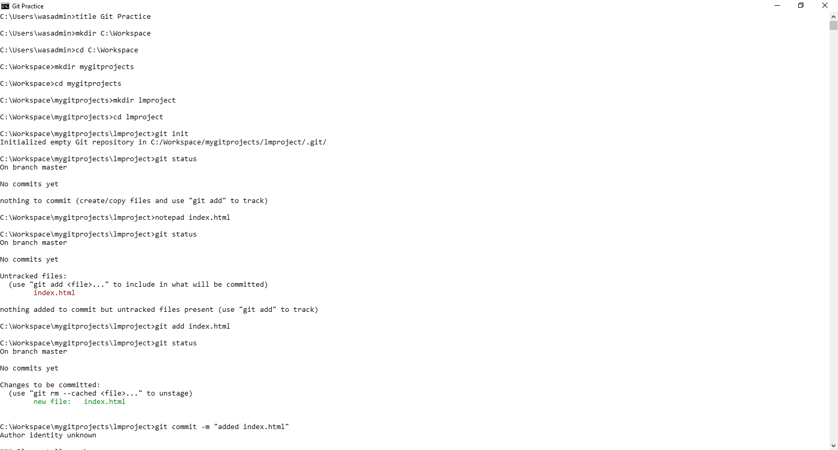
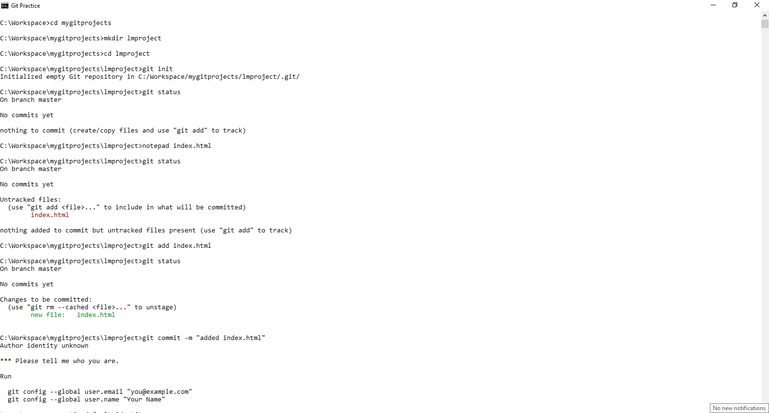
12. Class Exercise - 1
© 2024 Web Age Solutions All rights reserved

Slide 14
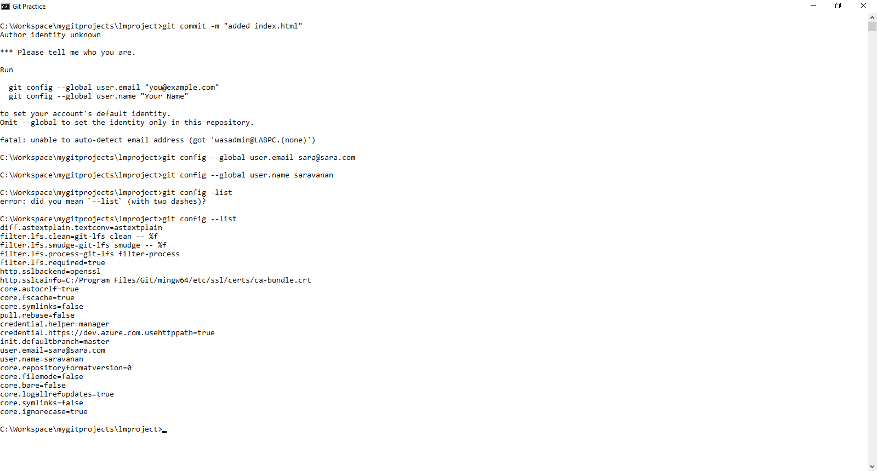
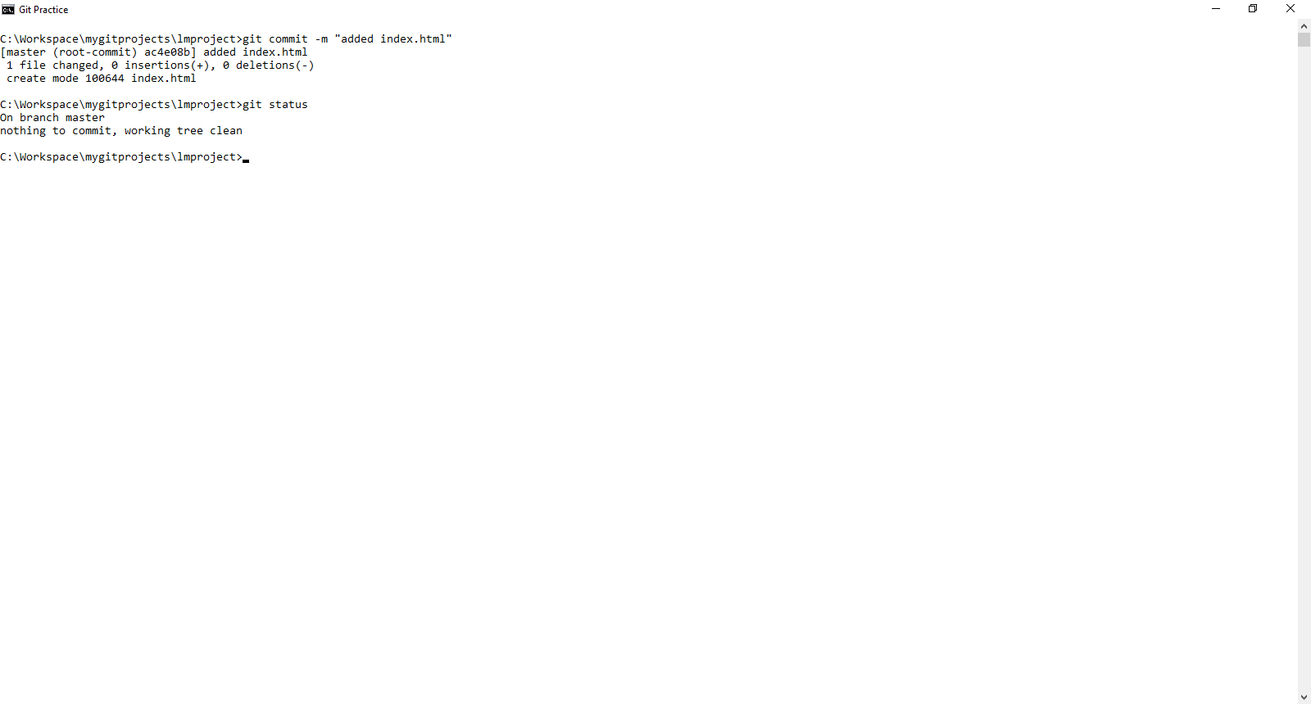
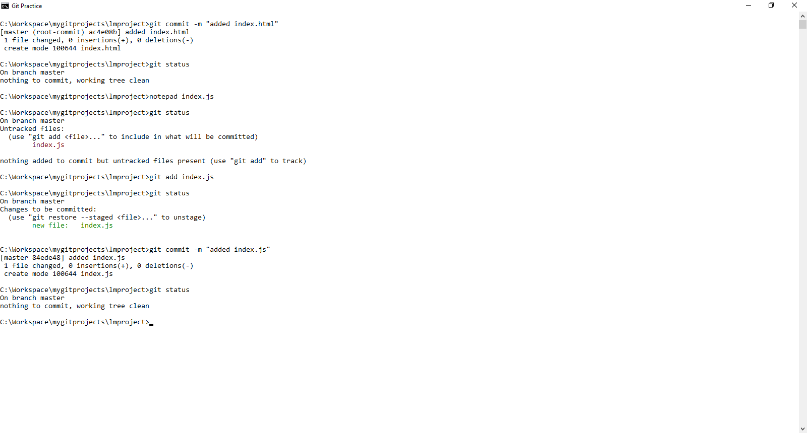
13. Class Exercise - 2
© 2024 Web Age Solutions All rights reserved

Slide 15
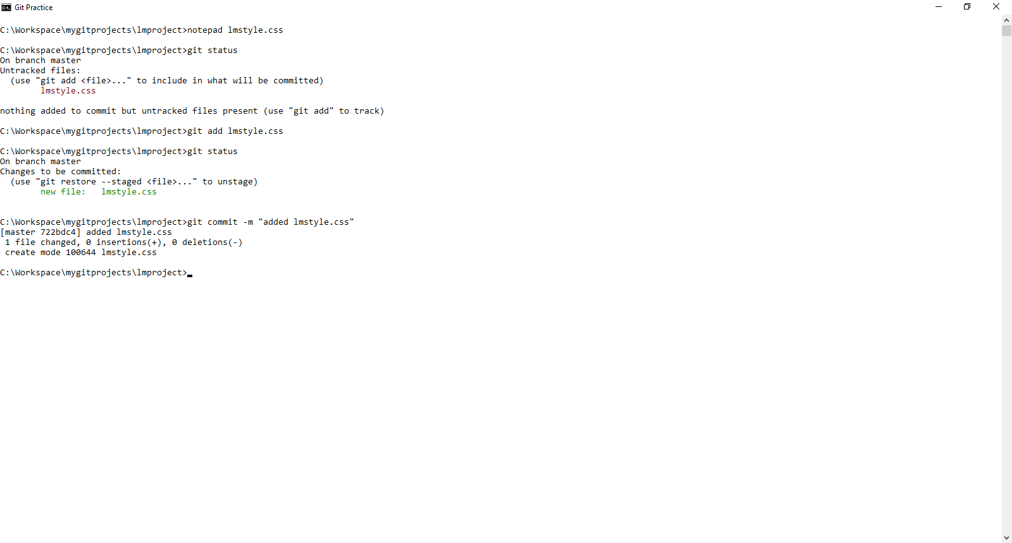
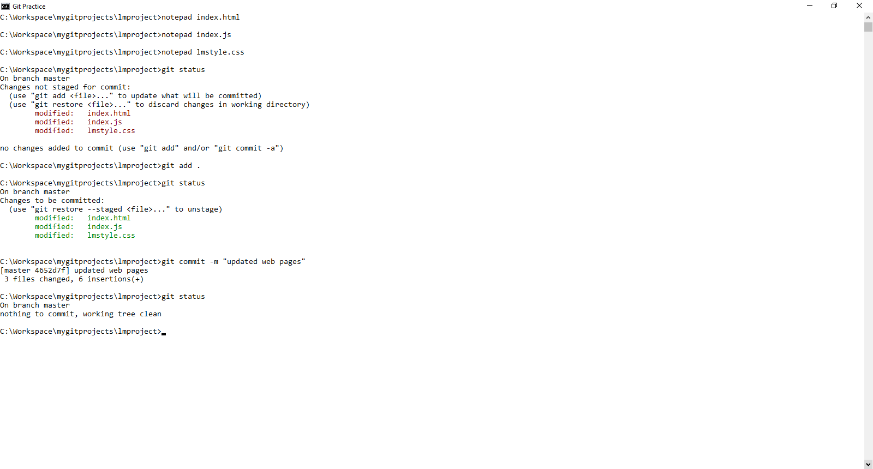
14. Class Exercise - 3
© 2024 Web Age Solutions All rights reserved

Slide 16
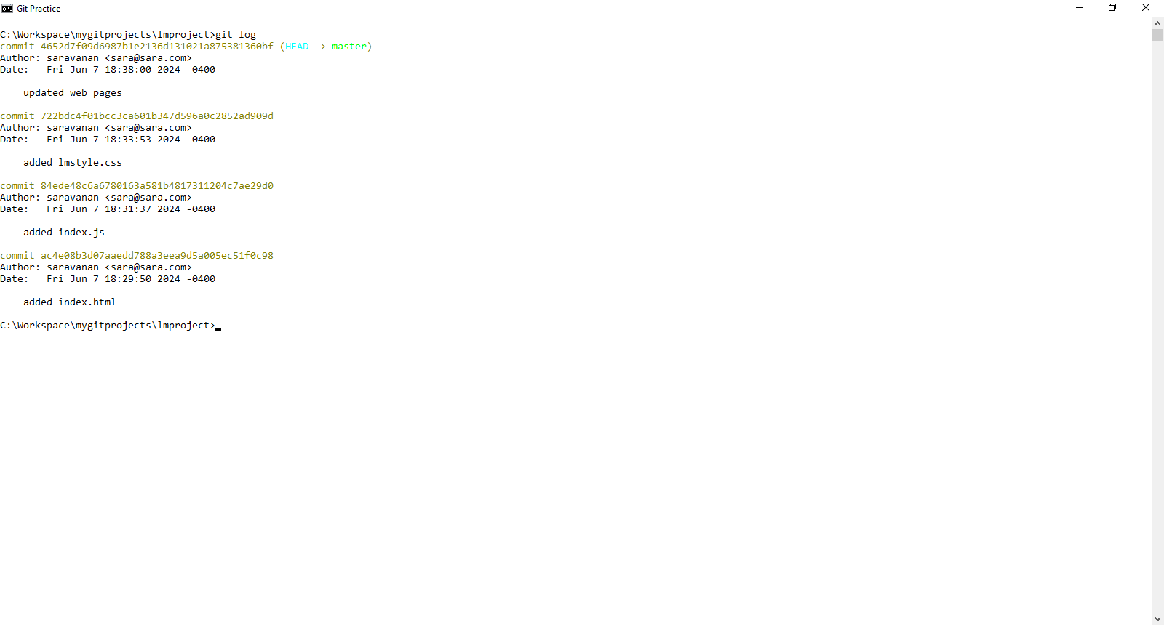
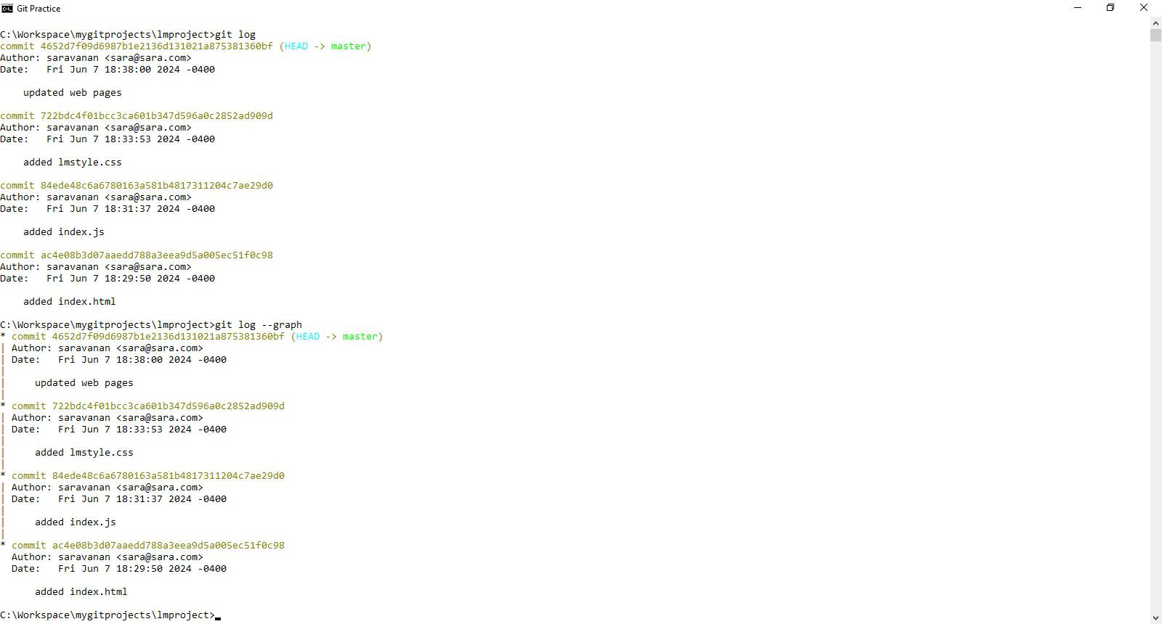
15. Class Exercise - 4
© 2024 Web Age Solutions All rights reserved

Slide 17
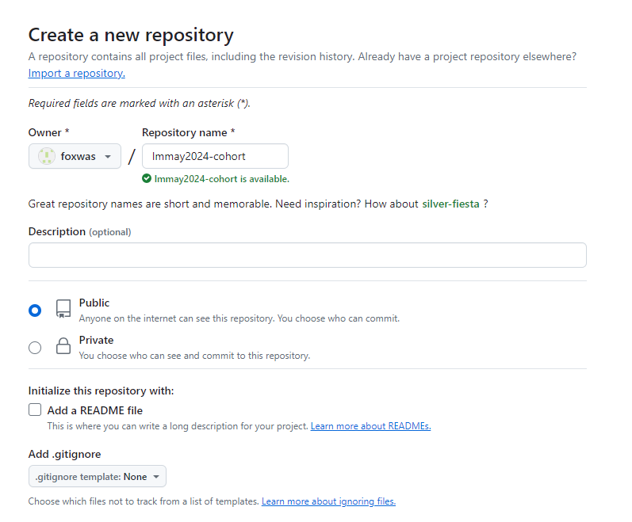
16. Class Exercise – 5 Remote Repository – Git Hub
Create a personal GitHub Account
https://github.com/signup
Login to your personal GitHub Account
Create a GitHub Repository
Owner ____
Repository name
lmmay2024-cohort
Description
Public
Add a README file
Add .gitignore
© 2024 Web Age Solutions All rights reserved

Slide 18
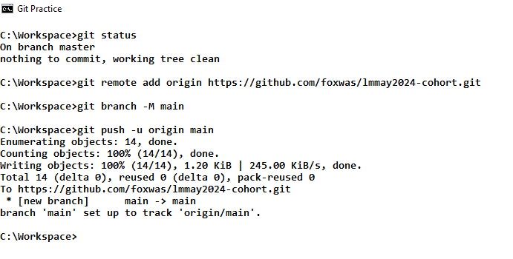
17. How to add remote repository to Local repo configuration?
To create a new repository on the command line in your computer and add your repo contents to GitHub remote repository
echo "# lmmay2024-cohort" >> README.md
git init
git add README.md
git commit -m "first commit"
git branch -M main
git remote add origin https://github.com/foxwas/lmmay2024-cohort.git
git push -u origin main
To push an existing repository in your computer from the command line, add repo contents to GitHub remote repository
git remote add origin https://github.com/foxwas/lmmay2024-cohort.git
git branch -M main
git push -u origin main
© 2024 Web Age Solutions All rights reserved

Slide 19
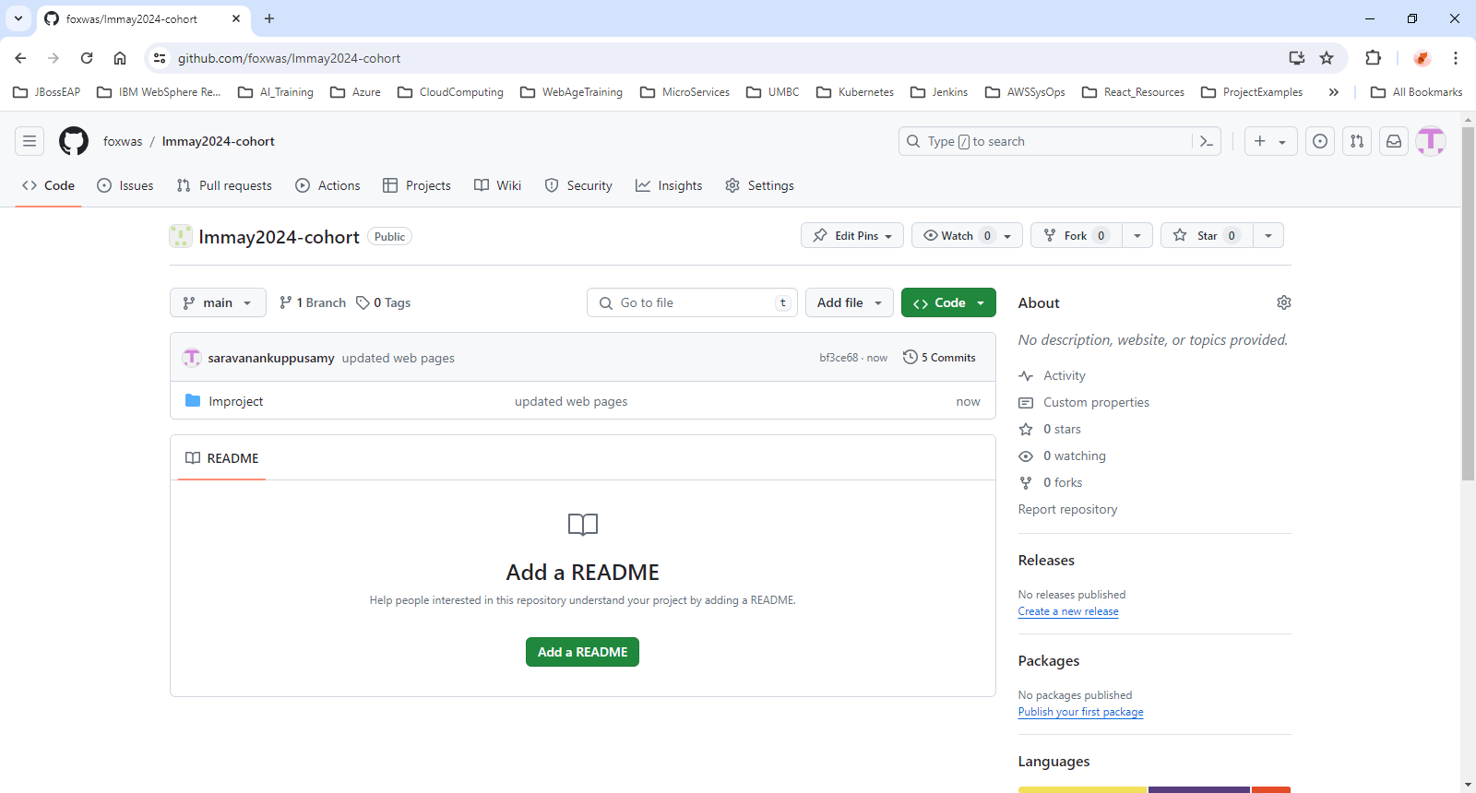
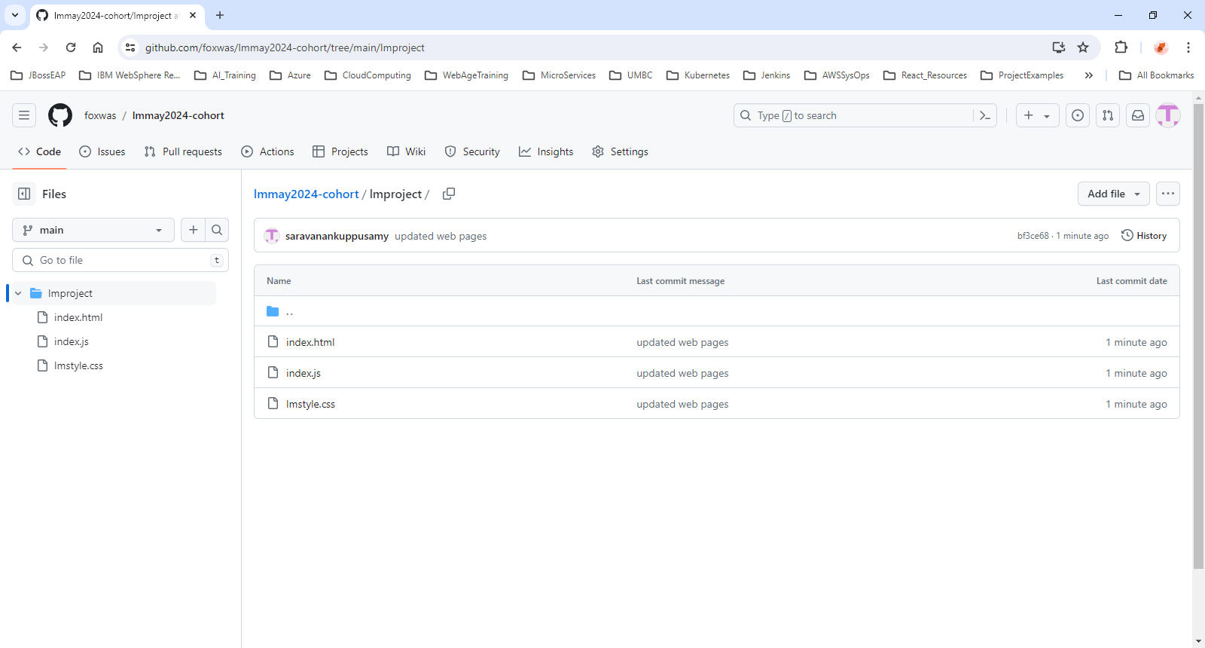
18. Local Repo - Remote Repository Synchronized
© 2024 Web Age Solutions All rights reserved

Slide 20
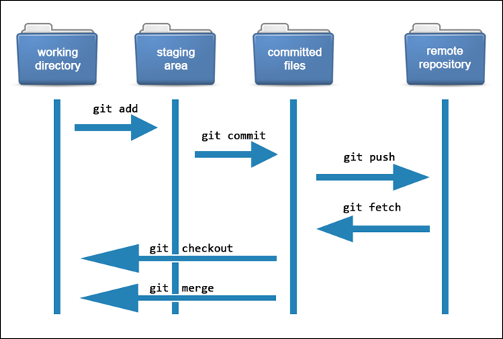
19. Git Overview – Illustration 1
https://phoenixnap.com/kb/how-git-works
© 2024 Web Age Solutions All rights reserved

Slide 21
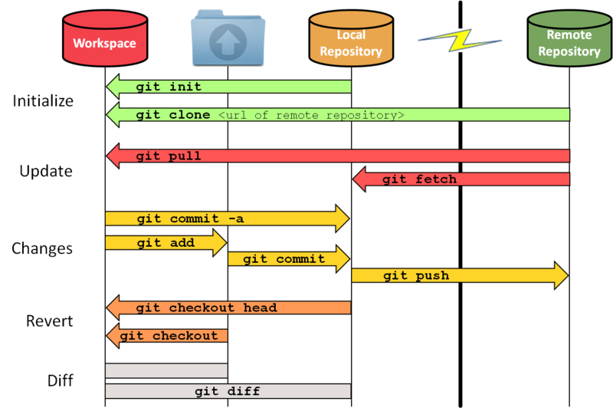
20. Git Overview – Illustration 2
https://medium.com/analytics-vidhya/git-most-frequently-used-commands-9df9f200c235
© 2024 Web Age Solutions All rights reserved

